Slide 1
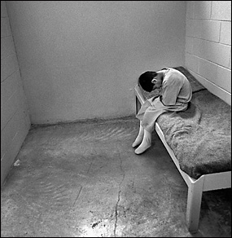
Juvenile Law

Slide 2
History of Juvenile Law
Originally, juvenile offenders were treated the same as adult criminals
Beginning in _________,__________________ ______________________________________
States took responsibility for parenting the children until they showed signs of positive change
Why do you think states
made this change?

Slide 3
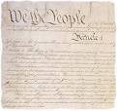
Rights of Juveniles and In Re Gault
The ______________of the Constitution states that "No person shall be held to answer for a capital, or otherwise infamous crime, unless on a presentment or indictment of a __________…nor shall [a person] be compelled in any criminal case to be a witness against himself, nor deprived of life, liberty, or property, without _____ ______________ of law."

Slide 4
Rights of Juveniles and In Re Gault
The _______________________ states that "No State shall make or enforce any law which shall abridge the ___________________ of citizens of the United States; nor shall any State deprive any person of life, liberty, or property, without ___________________; nor deny to any person within its jurisdiction the equal protection of the laws."

Slide 5
Rights of Juveniles and In Re Gault
Who: Gerald Gault, age 15
What:
Accused of making an obscene phone call to his neighbor.
Gault said that his friend made the phone call.
Police placed Gault in detention without _____________________.
One week later a judge sentenced Gault to the State Industrial School until Gualt turned 21 years old.
No _________ or _________ were present at the trial.

Slide 6
Rights of Juveniles and In Re Gault
__________ _______________decision:
Juvenile Courts must respect the _____ ____________rights of juveniles during their proceedings.
Youth have the following rights under the law:
The right to receive notice of charges
The right to obtain legal counsel
The right to "confrontation and cross-examination"
The "privilege against self-incrimination"
The right to receive a "transcript of the proceedings," and
The right to "appellate review"

Slide 7
Questions from Gault
Do you think that this decision helps or harms juveniles? Why?
Do you think that juveniles should have the same rights as adults? Why?

Slide 8
What is the Purpose of Criminal Law?
Punishment
“Eye for an Eye”
Way for society to take revenge
Prevention
Discourage offender from committing crimes in the future
Discourage future offenders
Incapacitation
Lock up in jail
Protect society from offender
Rehabilitation
Focus on changing behavior to lead a productive life
Examples: vocational programs, counseling
What do you think is the
goal of juvenile justice?

Slide 9
Key Terminology
Criminal System | Juvenile System
Defendant
Trial by jury | Adjudication, not all states give juveniles the right to a jury trial
Sentencing
Crime | Offense
Criminal
Guilty
Sentenced based upon offense | Sentencing varies, many options

Slide 10
Activity
4 Cases, 4 Crimes, You Be the Judge

Slide 11
Review From Yesterday
_________ ___________did not always exist in the U.S.
In Re Gault held that juveniles must receive ______ __________ of the law.
Juvenile Law and Criminal Law are NOT the same
Rehabilitation vs. punishment
Offender vs. Criminal
Sentencing based upon individual vs. predetermined sentencing

Slide 12
Juvenile Law in Minnesota
Juvenile System
Criminal System
Apprehended by police
Arrested by police
Petitioned for an offense
Charged with a crime
Found by court to have committed offense
Found guilty by court
Sentenced to an adult correctional facility for a specified period of time
Receive a disposition to be placed in a juvenile facility

Slide 13
Minnesota Juvenile Justice System
Certified as an Adult/ Extended Jurisdiction Juvenile
Over 14 and charged with a felony
Under age 10 at Time of offense
Age 10-17 at time of offense
Found not to have committed charge
Admits to offense charge
Denies Charge
Found to have committed charge

Slide 14
Apprehension
Most ____________ are done by _______ ____________
If the juvenile is between _____ and ________years of age, the case is referred to juvenile court and is considered rehabilitative
If the juvenile is younger the ________ years of age, the case is sent to juvenile court as a ________________________and social services becomes involved

Slide 15
Juvenile Court
Usually a _____________which means the judge is the only fact finder and there is no jury
Judge determines if the youth is ____________
If youth is determined delinquent, the judge sets a date for the ___________ ______________

Slide 16
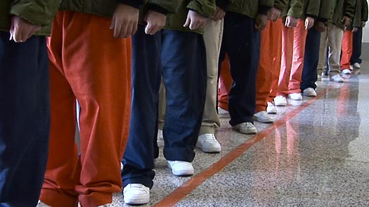
Certified as an Adult & Extended Jurisdiction Juvenile
Occurs at Disposition Hearing
May be certified as an adult if:
Older than ______years of age and charged with a _______
Age _______or older and charged with first degree murder
If convicted, will receive an _______ ____________
Extended Jurisdiction Juvenile
Between ___and ____years of age and charged with a felony
Given a juvenile disposition and the adult sentence is stayed
http://www.youtube.com/watch?v=AZ0P66NGQ0U&feature=related
Notes:
Vocabulary to Review
Felony: the Federal government defines a felony as a crime punishable by death or imprisonment in excess of one year. If punishable by exactly one year or less, it is classified as a misdemeanor. Crimes commonly considered to be felonies include, but are not limited to: aggravated assault and/or battery, arson, burglary, illegal drug use/sales, grand theft, robbery, murder, rape, and vandalism on federal property. Broadly, felonies can be categorized as either violent or non-violent (property and drug) offenses.
Stayed: the juvenile is first given the chance to complete the terms of the juvenile disposition. If the juvenile fails to complete the juvenile disposition, the adult sentence, which may include incarceration in an adult correctional facility, takes effect.

Slide 17
Tried as Adults: Cruel and Unusual Punishment?
The ________ Amendment of the U.S. Constitution prohibits the infliction of “_________ and unusual punishment.”
When juveniles are tried as adults they may receive life in prison without _______ or the _____ _____________
Do you think these punishments are cruel and unusual?

Slide 18
Juveniles as Adults
When do you think a juvenile should be tried as an adult?
Why should a juvenile be tried as an adult?
Why should a juvenile NOT be tried as an adult?
http://www.youtube.com/watch?v=vTzEThnv-vk&feature=related

Slide 19
Activity
Juvenile Law Jeopardy

