Slide 1
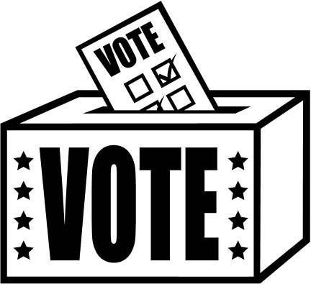
MINNESOTA’S VOTER ID AMENDMENT
Needed reform or a civil rights violation?

Slide 2
DEMOCRACY
If elections are meant to reflect the will of the people Governed which is the greater threat?
LACK OF PARTICIPATION
Or
Unlawful participation

Slide 3
THREATS TO DEMOCRACY
LACK OF PARTICIPATION
UNLAWFUL PARTICIPATION
Voter apathy
Burdens and barriers to voting rights (such as poll taxes)
Unlawful disenfranchisement of voters on the basis of race/sex/property ownership, etc.
Voter impersonation
Vote selling
Multiple voting
Felon voting
Nonresident voting

Slide 4
SOME POSSIBLE SOLUTIONS
LACK OF PARTICIPATION
UNLAWFUL PARTICIPATION
Make voting mandatory
Make registration as easy as possible (such as through same-day registration)
Stringent enforcement of voting rights act through lawsuits and prosecutions by federal government
Maintain photo database of registered voters at polls
Keep voter registration records up to date
Keep record of convicted felons and inform felons that they are not entitled to vote under MN law
Require documentation of residency when registering

Slide 5
THE PROPOSED AMENDMENT
(a) Every person 18 years of age … who has been a citizen of the United States for three months and who has resided in the precinct for 30 days next preceding an election shall be entitled to vote in that precinct. (b) All voters voting in person must present valid government-issued photographic identification before receiving a ballot. The state must issue photographic identification at no charge to an eligible voter who does not have a form of identification meeting the requirements of this section. A voter unable to present government-issued photographic identification must be permitted to submit a provisional ballot. A provisional ballot must only be counted if the voter certifies the provisional ballot in the manner provided by law. (c) All voters, including those not voting in person, must be subject to substantially equivalent identity and eligibility verification prior to a ballot being cast or counted.

Slide 6
EFFECTS OF PASSAGE
Make ELECTION LAW INTO CONSTITUTIONAL LAW AND REQUIRE A REFERENDUM TO CHANGE THE LAW GOING FORWARD.
215,389 legal voters would need to get photo ids which they currently do not possess (Sec. of State’s Estimate).
Would establish 30-day citizenship requirement and expand residency requirement to 30 days to vote in a precinct.
Would require state to provide photo ids for free to anyone requesting them and providing the necessary documentation

Slide 7
ARGUMENTS
SUPPORTING AMENDMENT
OPPOSING AMENDMENT
The amendment is meant to stop voter fraud by requiring that voters be able to prove they are in fact the people who are registered.
Most people already have the required ID. If they don’t or if they forget it, they can cast provisional ballots which will be counted if they show the ID within a few weeks of the election.
Measure is meant to ensure that elections are fair. If voter fraud occurs, elections are not reflections of the will of the people.
Many of those registering for same-day voting already show an ID anyway, and this has not been a problem.
The Amendment addresses a non-existent problem – only 1 person is known to have been convicted of voter impersonation in MN.
The Amendment will disproportionally affect students, the elderly and the military who are less likely to have the proper ID, despite lawfully being registered to vote.
Requiring ID doesn’t solve the problem. No ID contains all the information that would need to be proven.
Other options are available that are less likely to disenfranchise people.

Slide 8
THINGS TO THINK ABOUT
WHAT MAKES A FAIR ELECTION?
HOW SHOULD WE BALANCE THE NEED TO PREVENT ILLEGAL VOTING AGAINST THE NEED TO ENSURE THE CONSTITUTIONAL RIGHT OF THOSE VOTING LEGALLY?
WHAT WOULD BE THE LONG-TERM CONSEQUENCES OF PASSING THIS AMENDMENT?
IS IT IMPORTANT THAT OUTSIDE INTEREST GROUPS ARE INVOLVED?

Slide 9
SNAP DEBATE
EACH SIDE TAKES A POSITION
PICK SOMEONE TO GIVE THE BASIC ARGUMENTS
PICK SOMEONE ELSE TO EXPLAIN SOME OF THE REASONS FOR THE POSITION
ANSWER QUESTIONS FROM JUDGES AND EACH OTHER
JUDGES DECIDE/WE DISCUSS

