Slide 1
Federalism and Lawmaking

Slide 2
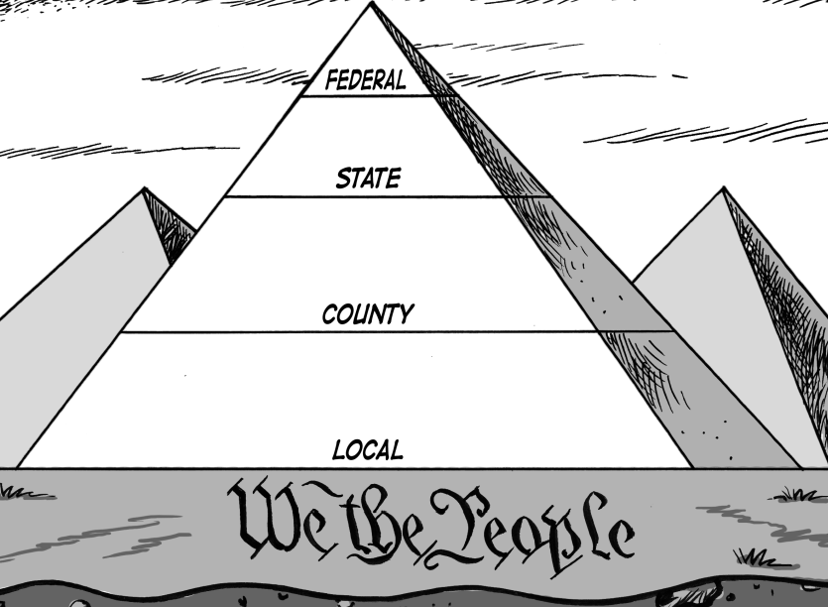
A Parallel and Dual System
The U.S. Constitution establishes a government based on "federalism," or the sharing of power between the national, and state (and local) governments.
While each of the 50 states has its own constitution and laws, all provisions of state constitutions and laws must comply with the U.S. Constitution and federal laws.
Under the U.S. Constitution, both
the national and state governments
are granted certain exclusive powers
and share other powers.

Slide 3
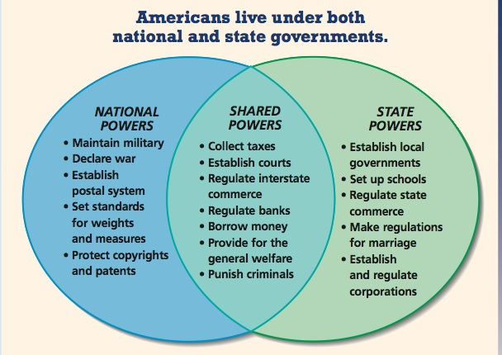

Slide 4
Each with the power to make laws
Each state and the federal government can make laws to exercise the powers described in the constitutions.
U.S. Constitution
Federal Laws
Minnesota Constitution
Minnesota State Laws
Local Laws

Slide 5
How are laws made?

Slide 6
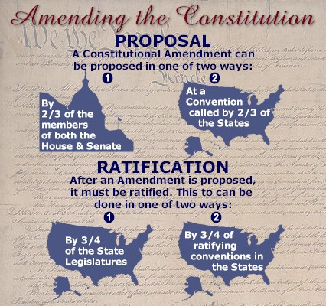
The United States Constitution

Slide 7
State Constitutions
Each state has its own process for amending its constitution. The Minnesota Constitution can be amended by:
The legislature proposes a constitutional amendment that appears on the MN ballot and is put to vote before citizens of Minnesota.
The legislature can ask voters to call for a constitutional convention.
OR

Slide 8
Amendments
Though there are procedures for amending the Constitution, it is rarely amended.
There have only been 27 amendments to the US Constitution since it was ratified in 1788.
So how do the state and federal governments exercise their powers?

Slide 9
How the Legislature Makes Laws
http://www.youtube.com/watch?v=H-eYBZFEzf8

Slide 10
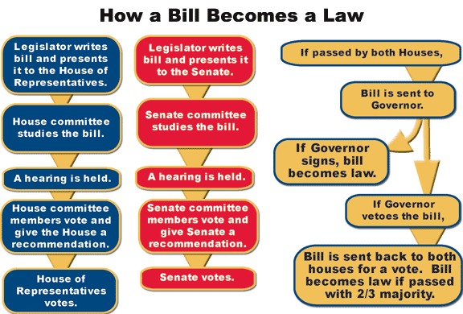
How the Legislature Makes Laws
Though each state has its own process, many of them are very similar to the federal process:

