Slide 1
Bring civics and government to life with trusted online resources!
teachingcivics.org team
JoEllen Ambrose
joellen.ambrose@anoka.k12.mn.us
Rich Rosivach
richard.rosivach@moundsviewschools.org
Charlie Skemp
charles.skemp@isd197.org
Filiz Yargici
filiz.yargici@isd623.org
Jennifer Bloom
jbloom@teachingcivics.org

Slide 2
Why this workshop?
Share online resources we like, we have tried, we trust
Online resources are often
  Inaccurate
  Biased
  Agenda-driven
  Not teacher or student friendly

Slide 3
60 Second Snapshot
All resources sent to us for review
election page http://2012.candidate-comparison.org/?compare=Romney&vs=Obama
Bill of Rights slides on TED talks http://ed.ted.com/lessons/a-3-minute-guide-to-the-bill-of-rights-belinda-stutzman
human rights curriculum http://www.humanrights.com/#/home
http://www.scientology.org/how-we-help/human-rights.html

Slide 4
Connection to Standards
Use the skills required in benchmark 9.1.1.1.3
“Evaluate sources of information and various forms of political persuasion for validity, accuracy, ideology, emotional appeals, bias and prejudice.”
Website evaluation checklist
http://www.lib.umd.edu/binaries/content/assets/public/usereducation/evaluating-web-sites-checklist-form-spring-2014.pdf

Slide 5
Fasten your seatbelts!
Thinking about the BIG IDEAS

Slide 6
A look at the standards
“The United States is based on democratic values and principles that include liberty, individual rights, justice, equality, the rule of law, limited government, common good, popular sovereignty, majority rule, minority rights.” 9.1.2.2.1

Slide 7


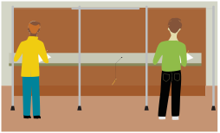






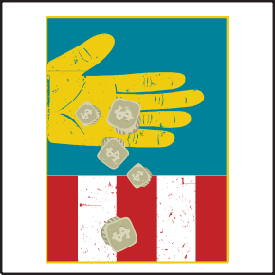
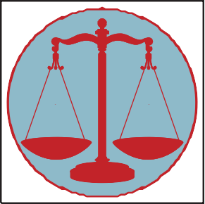




































Principles of Democracy
?
Bill of Rights

Slide 8
Principles of Democracy Activity
In your group:
  Discuss the definition
  Discuss how the principle strengthens democracy?
  Provide examples (both negative and positive) of the principle in history and current events
  Feel free to use headlines
Use as organizing theme for course

Slide 9
Principles of Democracy
From: www.dda.deliberating.org/
  Federally funded project, evaluated, lots of topics
Extension ideas
  Principles of Democracy in the News
  Other content areas
  Other democratic principles
  Four Key Constitutional Principles from Youth Leadership Initiative
  Help students meet the Common Core and Minnesota English Language Arts standards in Reading and Writing. https://sites.google.com/a/moundsviewschools.org/dda---march-2013/home
  https://sites.google.com/a/moundsviewschools.org/mcss---social-studies-and-ela-standards/home

Slide 10
Constitutional Principles and Types of Government
  Political Philosophy
    Why Government i-civics.pdf
    Preamble Constitution Natural Rights and Classical Republicanism Activty.docx
    Natural Rights Philosophy and Classical Republicanism Chart Student Handout.pdf
  Who Rules_2 icivics.pdf

Slide 11
Having fun with Constitutional Principles!
Brought to you by. . . .
www.teachingcivics.org

Slide 12
People Power Scale
(Popular Sovereignty)
Military Rule
Totalitarian Dictatorship
Communist state Constitutional Monarchy Absolute Monarch
Representative
Direct
ANARCHY DEMOCRACY OLIGARCHY AUTOCRACY
ALL PEOPLE POWER
Create a Country People Power Scale.docx
NO PEOPLE POWER

Slide 13

Autocracy is like a pencil because. . .
Create a Country Lesson.docx

Slide 14
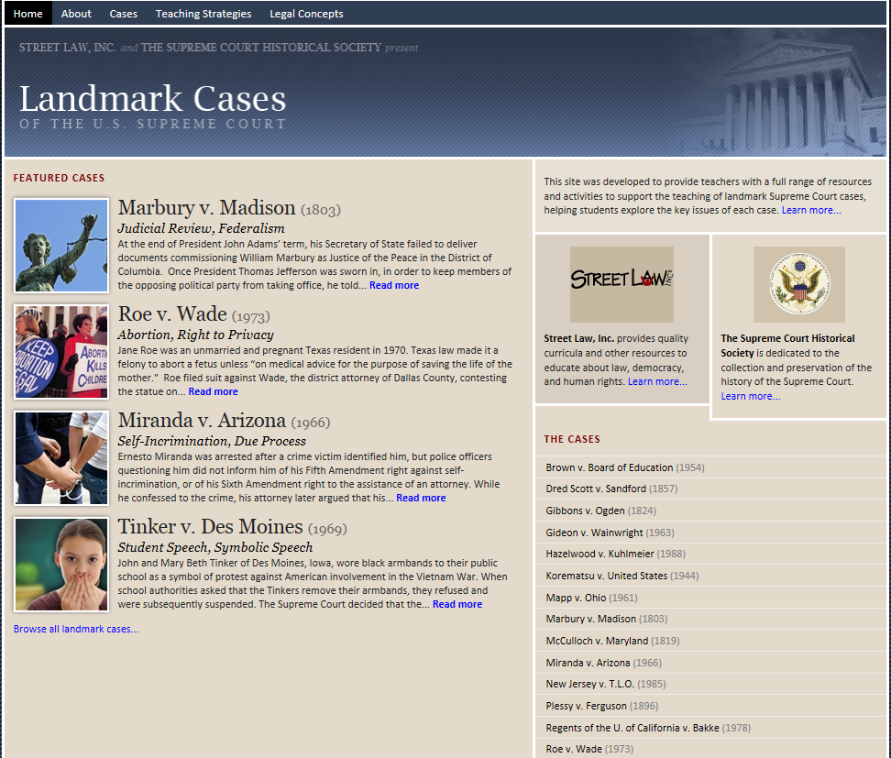

Slide 15
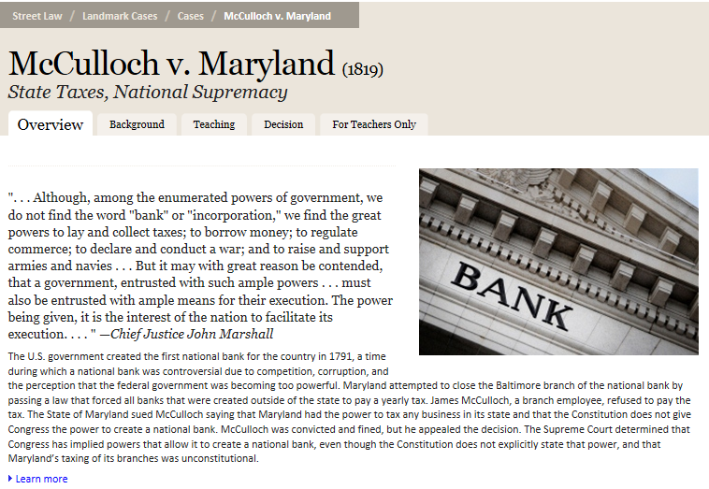

Slide 16
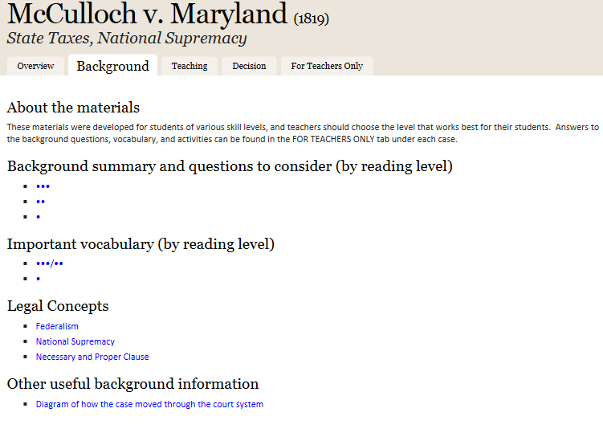

Slide 17
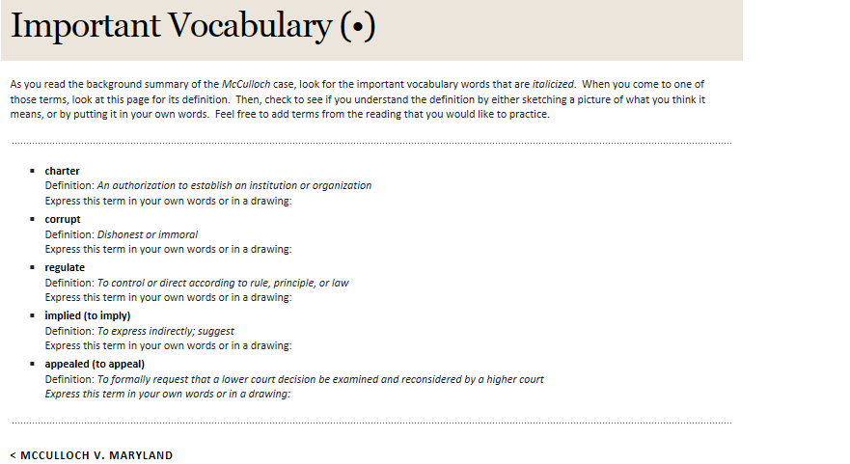

Slide 18
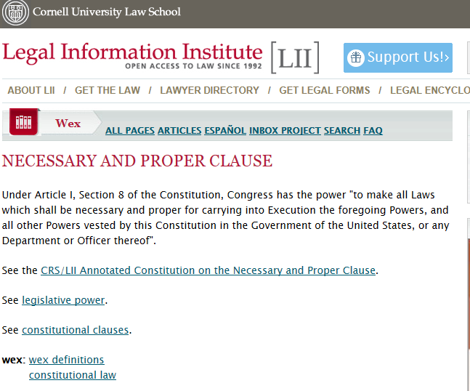

Slide 19
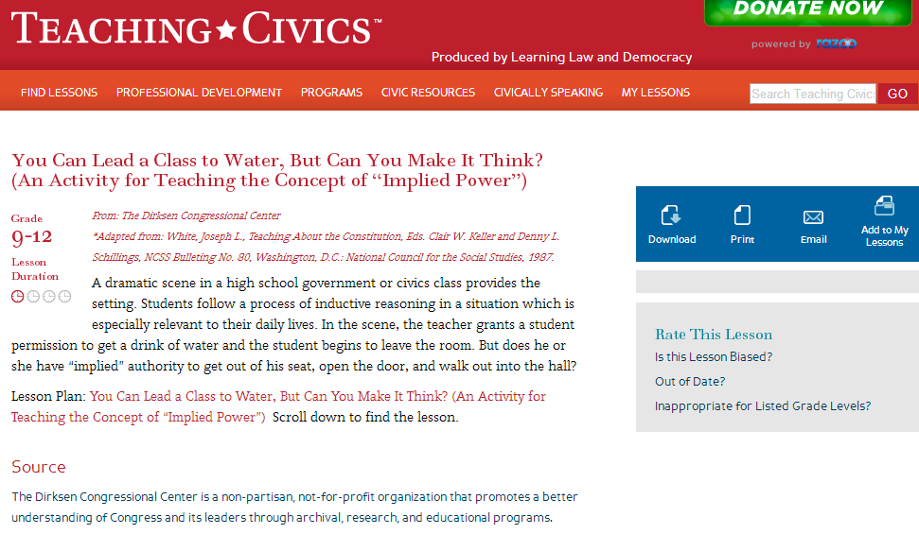

Slide 20

The Powers of Getting a Drink
Adapted Lesson Plan and alignment with Minnesota Social Studies Benchmarks.docx

Slide 21
Principles, Politics, and Polling
Jefferson Hamilton Lesson (2).pdf
biasespollslessonhs_eng_ver4 (1).docx
Budget Hero

Slide 22
What’s next
Finding resources to fill the gaps!
Latest find…
Ojibwe Treaty Rights
  Flipbook http://glifwc.org/publications/TreatyRightsFlipbook/index.html
  Also a DVD plus study guide
Ideas?

Slide 23
www.teachingcivics.org

