Slide 1
Welcome to
Super Civics
Animated Gif from https://gph.is/1KF7fFk

Slide 2
Teaching Civics - A Civic Education Project from Learning Law and Democracy

Slide 3
One Word
Ice Breaker
“Effective Engaged Adult Citizen”

Slide 5
Introductions and share your one word for an….
Effective Engaged Adult Citizen
Name
School, Position
Share your one word and post it near our Super Civics Super Hero

Slide 6
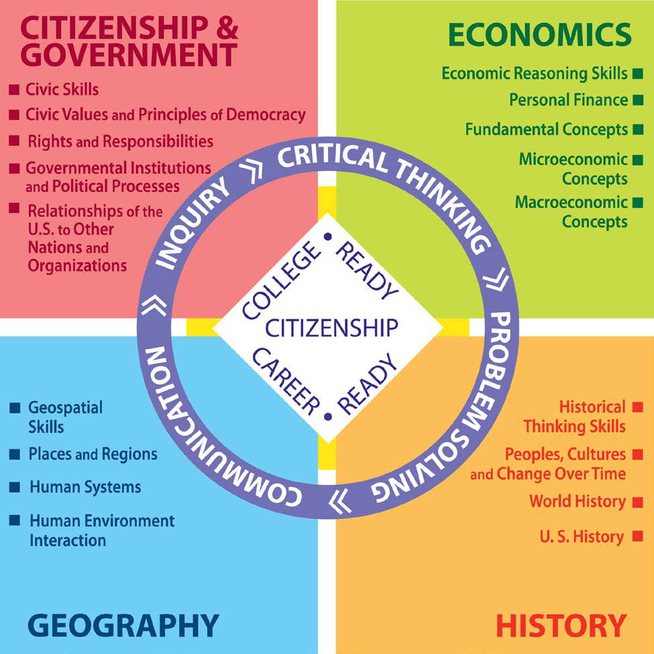
CITIZENSHIP & GOVERNMENT - Strand #1

Slide 7
Your benchmarks….
Benchmark Analysis:
Examine the benchmarks for your grade:
Identify one benchmark that you feel comfortable teaching. Star it ★
Identify one benchmark that is more challenging for you, or one that you wish to have more support in teaching. Circle it ⥀
Record any questions you may have related to that benchmark.
Let’s go back to our Kapows….Are we missing any words for our Effective Engaged Adult Citizen?

Slide 8
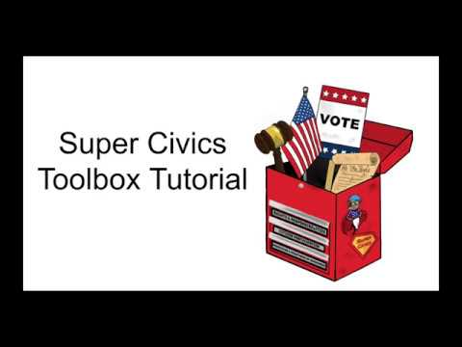
Super Civics Toolbox

Slide 9
Super Civics Toolbox
To access the Super Civics Toolbox, go to: bit.ly/SCtoolbox

Slide 10
Grade 2
Voting and the Common Good
Grade Two Slides

Slide 11
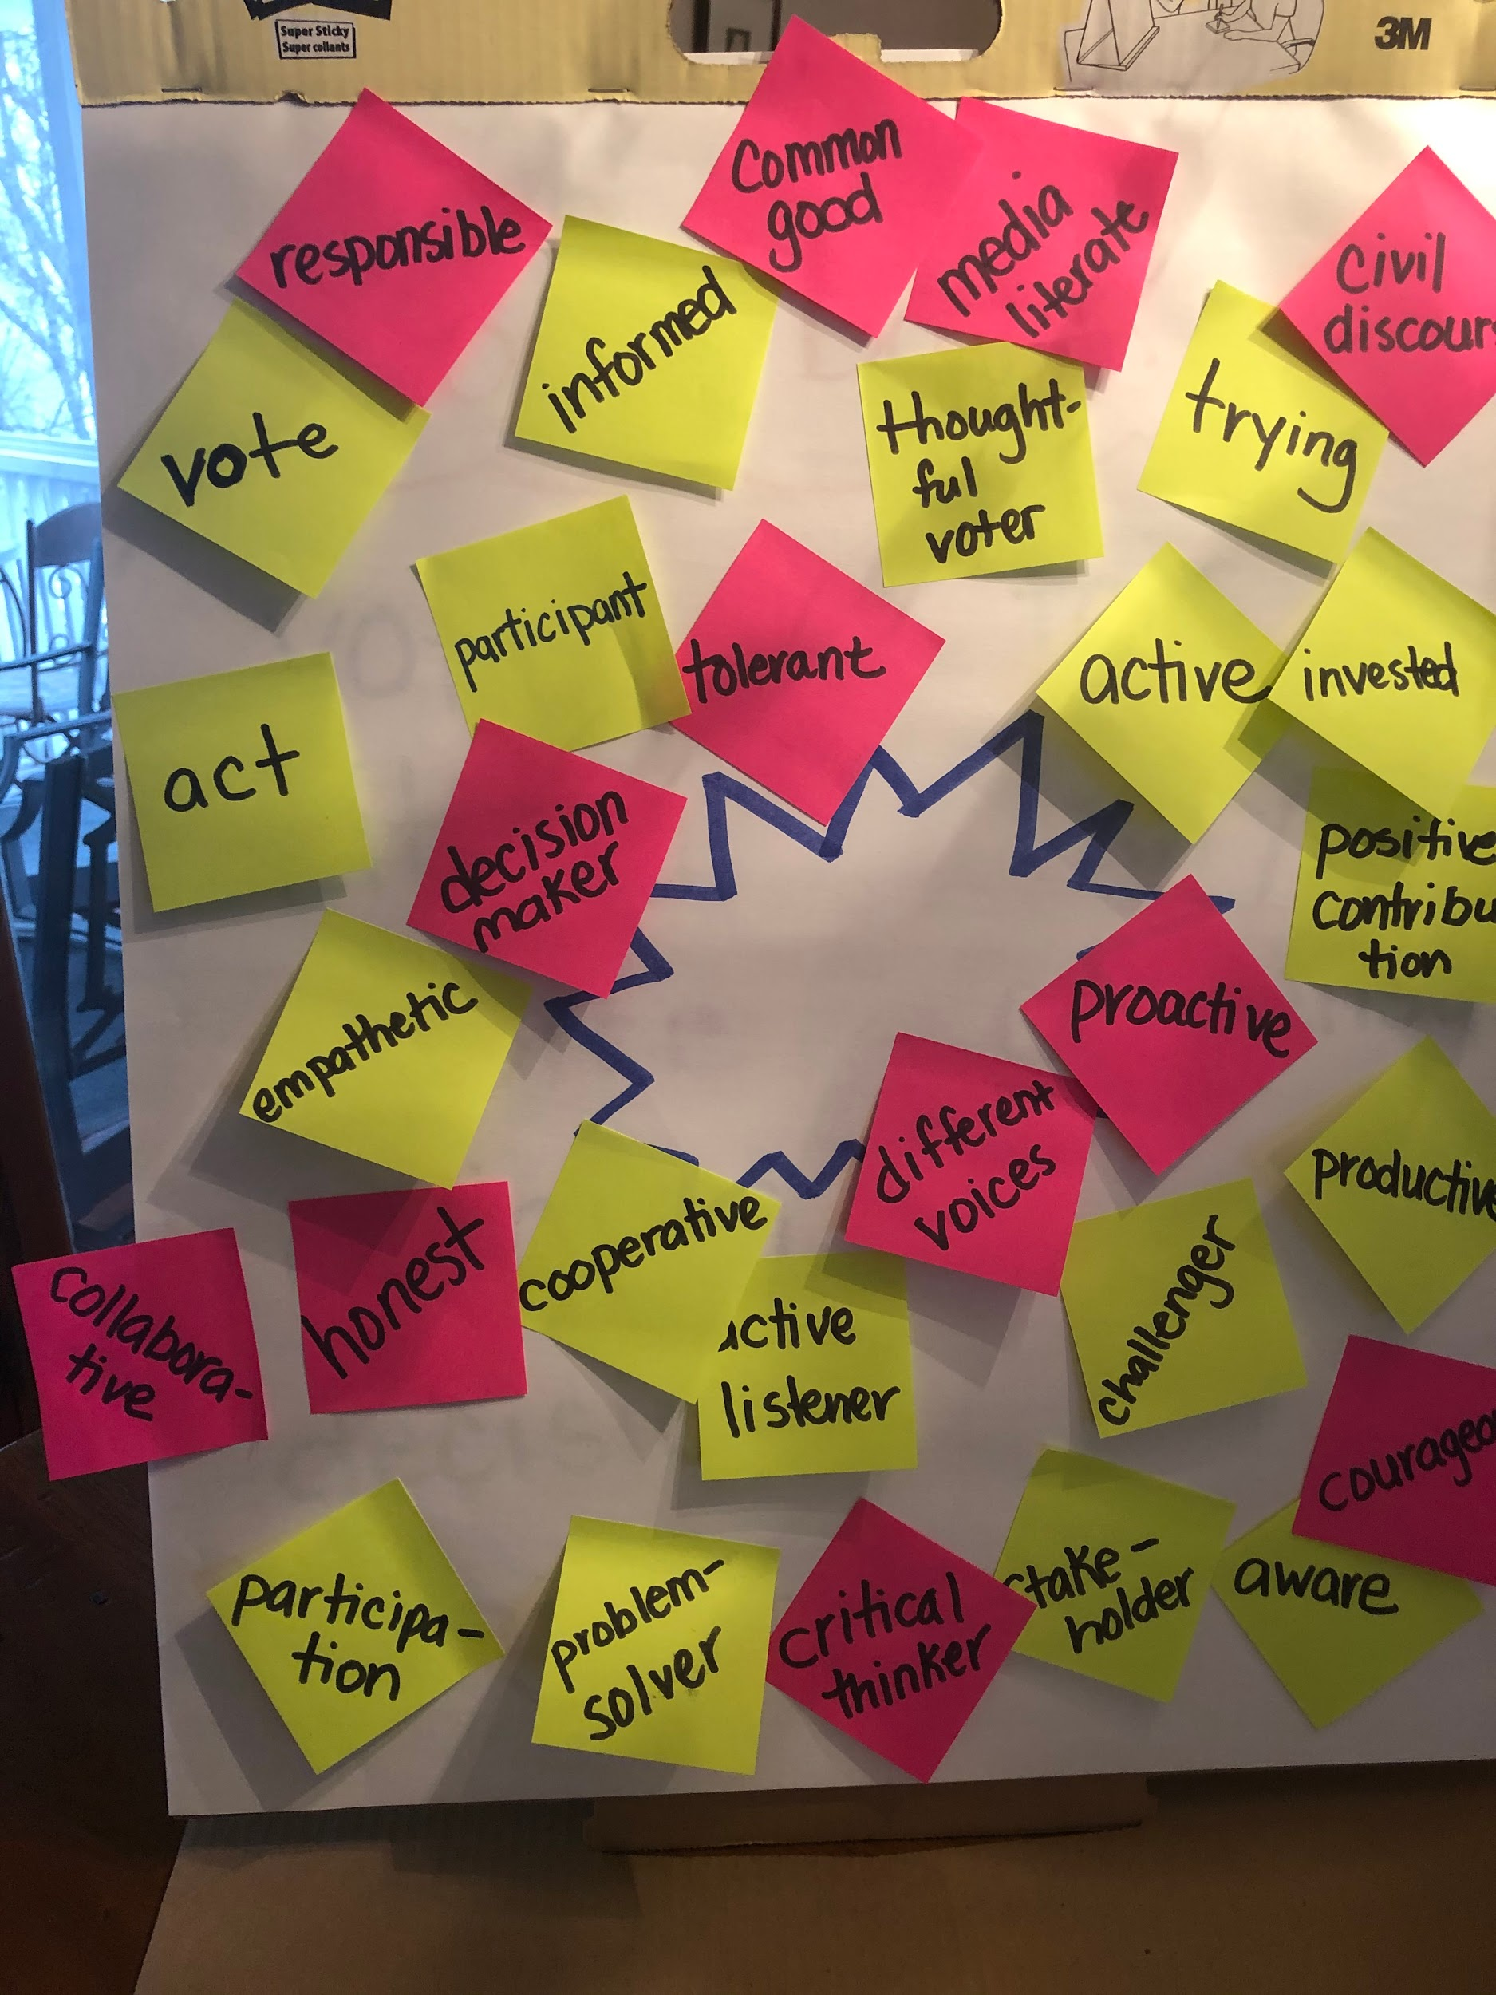
Super Civics
Effective Engaged Adult Citizen

Slide 12
For more information:
Online at TeachingCivics.org
By email info@teachingcivics.org
Through Twitter @teachingcivicsM

Slide 13
Super Civics Team/Presenters* | Position/Experience
Denise Evans | Retired Elementary Teacher. I have taught grades K, 3 and 5 in Anoka-Hennepin, Saint Paul Public Schools, Janesville Public Schools and Red Lake Public School.
Sara Benedett | NBCT K-6 Elementary Educator from SPPS,
*Phyllis Haensel phyllishaensel@gmail.com | MCSS Elementary Teacher of the Year 2016, Anoka-Hennepin School District teacher and curriculum writer
Morgan Reel | Teacher Librarian; Roosevelt Middle School (Anoka-Hennepin).
*Teresa Ponessa teresa.ponessa@gmail.com | Elementary Social Studies Methods Instructor, University of Saint Thomas, Director, Super Civics project
*Jennifer Bloom jbloom@teachingcivics.org | Director, Learning Law and Democracy Foundation
*JoEllen Ambrose joellen.ambrose@gmail.com | Civics consultant, curriculum writer, social studies methods professor

Slide 14
Animated Gif from https://gph.is/1KF7fFk

